Slide 1


DATA SCIENCE INDIVIDUAL PROJECT
MC353070
HR DATA ANALYSIS
Welcome to the world of HR data analysis, where we uncover insights and make data-driven decisions to improve workplace dynamics and employee satisfaction.
by Abban Justice
DATA SOURCE
https://www.kaggle.com/datasets/tawfikelmetwally/employee-dataset

Slide 2
HR Data Analysis
Welcome to the world of HR data analysis, where we uncover insights and make data-driven decisions to improve workplace dynamics and employee satisfaction.
Goal
The goal of this HR data visualization project is to leverage an organization or institution’s HR dataset to improve workforce management, leading to increased employee satisfaction, better resource allocation, and enhanced productivity.

Slide 3
Key Findings from the Data
1
Find the total of employees
2
Gender Ratio
3
Employment Status
4
Total Employee Attrition number
5
Rate of employee Attrition

Slide 4
Key Findings from the Data
6
Total number of employees
7
Employees Attrition by Department
8
Employee Attrition by Gender
9
Total 5 positions with number of employees
10
Employee Job Satisfaction Rate

Slide 5
Challenges encountered
Some challenges encountered includes:
Data Quality: I had to ensure that the data being used was quality. I therefore had to do some data cleaning to remove all null values to avoid misleading visualization.
Choosing the Right Visualization Type: Had to be very specific about the type of charts and graph to use to convey my message.
Color Selection: Selecting colors for my charts and graphs were so challenging though I had backgrounds in color grading and how primary and secondary colors are achieved. Therefore, had to spend some extra time to select a color scheme that is easy to interpret and accessible to all users.
4. Accessibility: Making visualization accessible to all users, including those with disabilities was a challenge. Especially for screen readers and color-blind individuals.

Slide 6
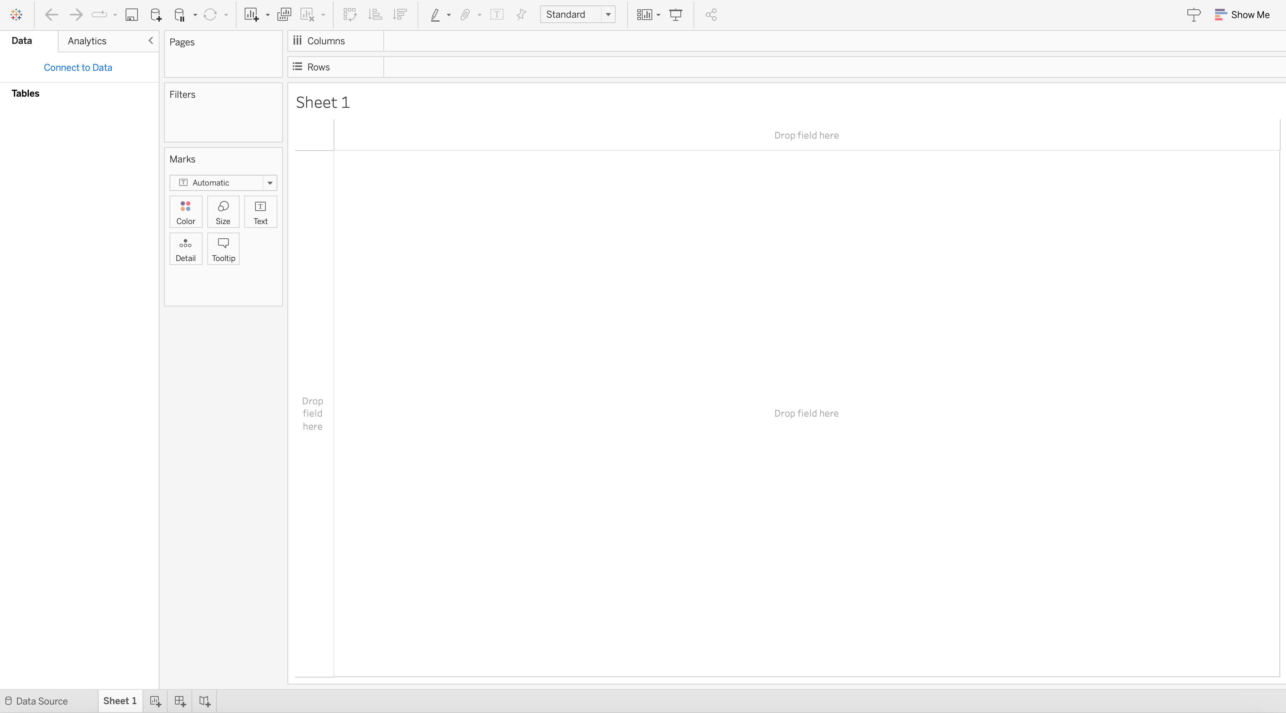
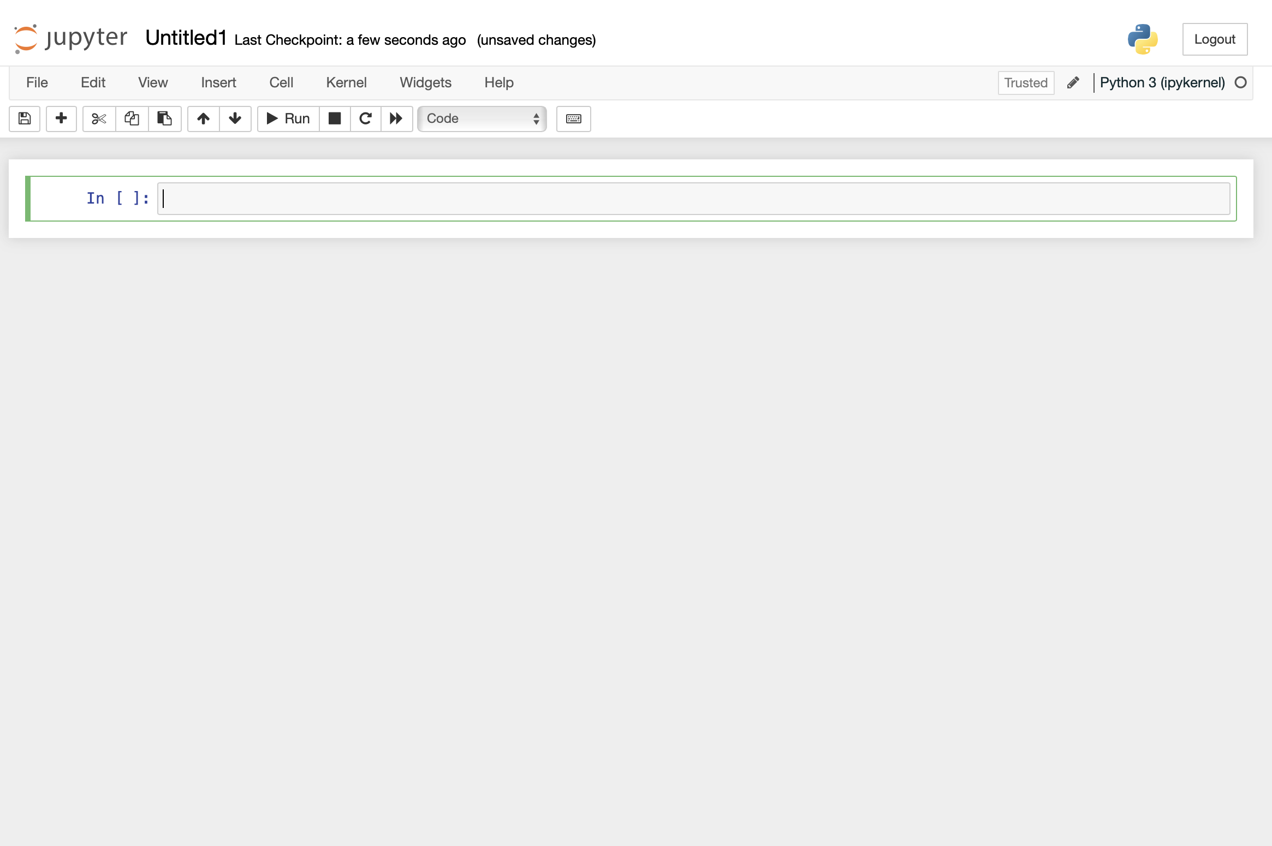
The Visualization of the Data
Interactive Dashboards
Data Cleaning
Create dynamic visualizations that allow stakeholders to explore HR metrics and trends in real-time using Tableau.
Cleaning data for accurate information for visualization.
I used Python in Anaconda .

Slide 7

Analytics Tools and Techniques Used
1
Removal of null
variables
2
Data Visualization
I did my data cleaning with Jupyter Notebook and python.
I used Tableau to create my sheets and Visualization Dashboard.

Slide 8
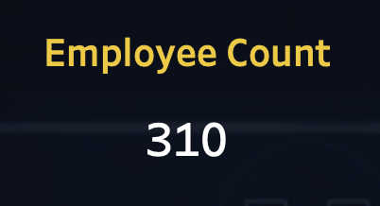
Employee Count
My dataset had a total of 310 Employees

Slide 9
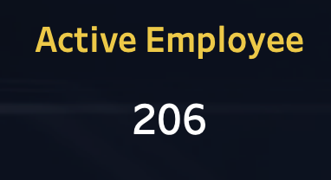
Active Employee
After carefully analyzing the dataset by subtracting the total number of employees from the total number of attrition I had 206 total active employees.

Slide 10
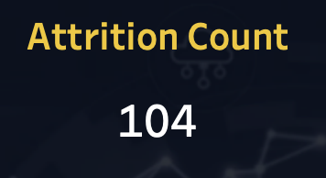
Attrition Count
This was derived by subtracting the number of Active employee from the tolan number of employees resulting to a number of 206 attrition employees count.

Slide 11
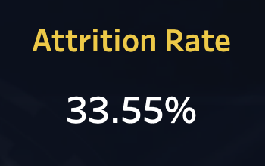
Attrition Rate
This was derived by converting the total number of attrition count to percentage.

Slide 12
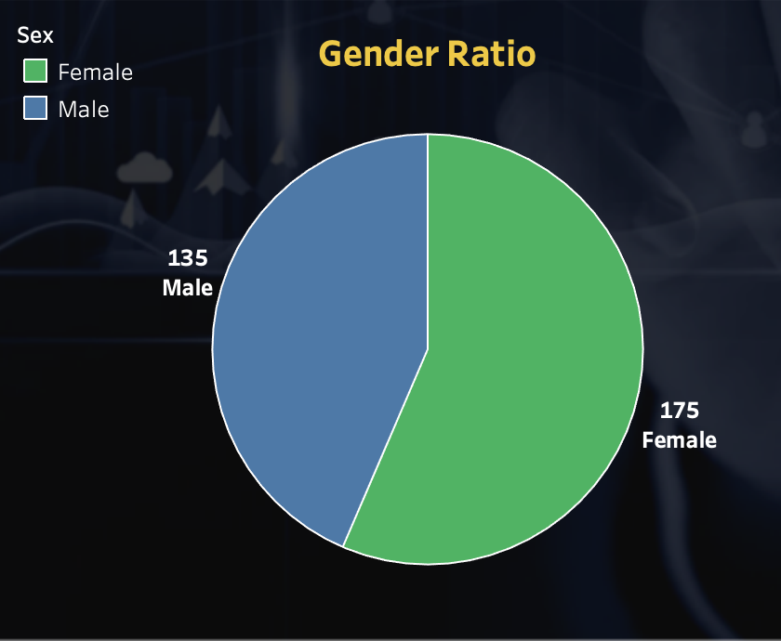
Gender Ratio
The dataset was classified by gender:
Male -135
Female - 175

Slide 13
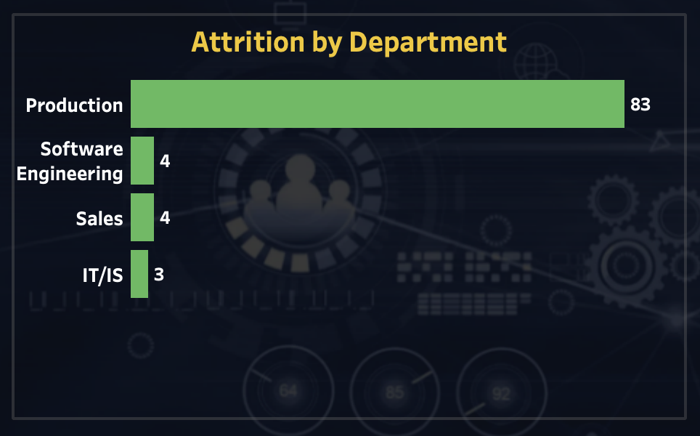
Attrition by Department
This defines the attrition by
the each department.

Slide 14
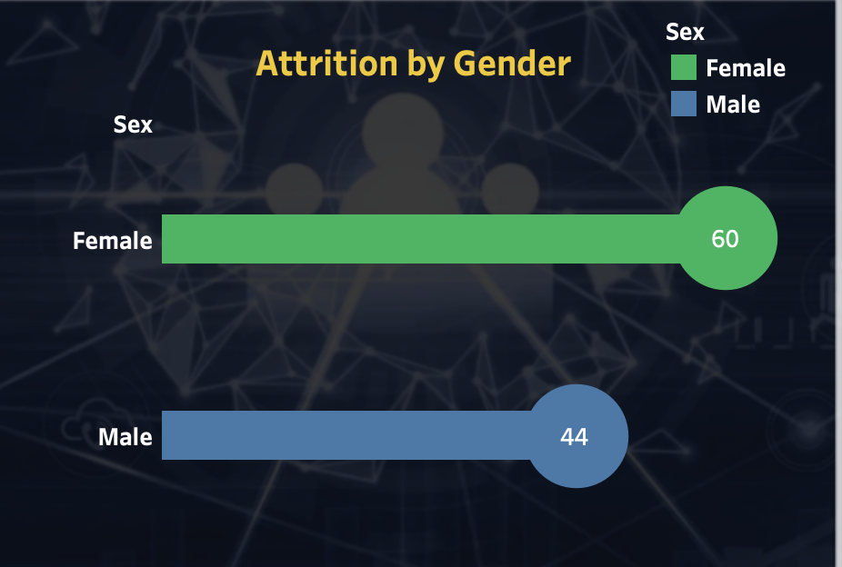
Attrition by Gender
This gives us the over view of
the total number of attrition by gender.
Male - 44
Female - 60

Slide 15
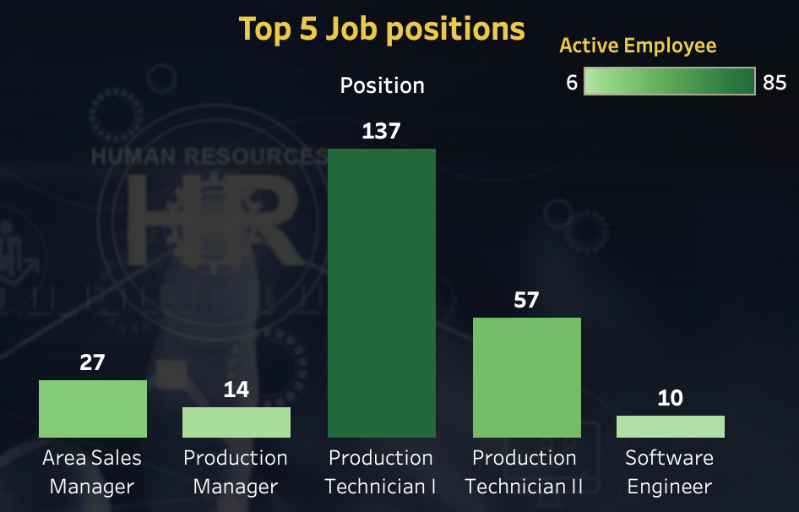
Top 5 Job positions
This bar chart tells us about the top 5 job positions and the number of employee/active employees.

Slide 16
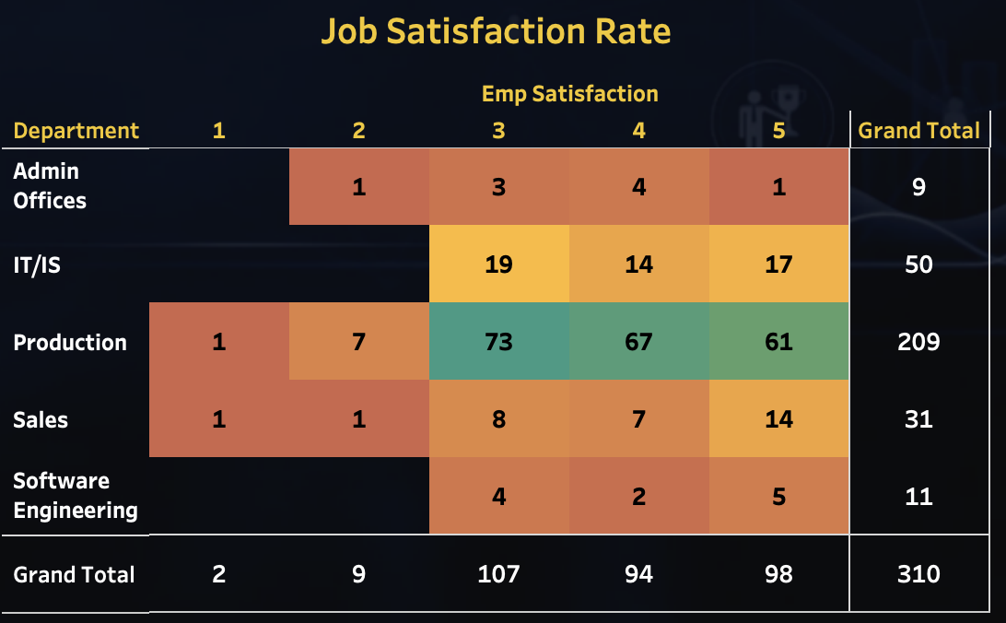
Job Satisfaction Rate
This table gives us the total overview of Employment job satisfaction rate by department.

Slide 17
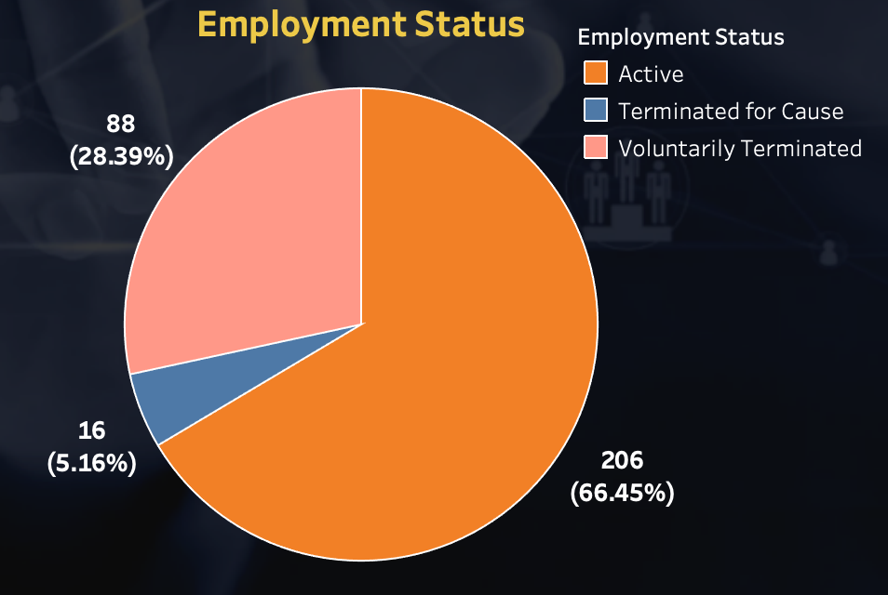
Employee Status
Employee Status defines the status
of employees according to:
Active
Terminated for cause
Voluntarily Terminated

Slide 18
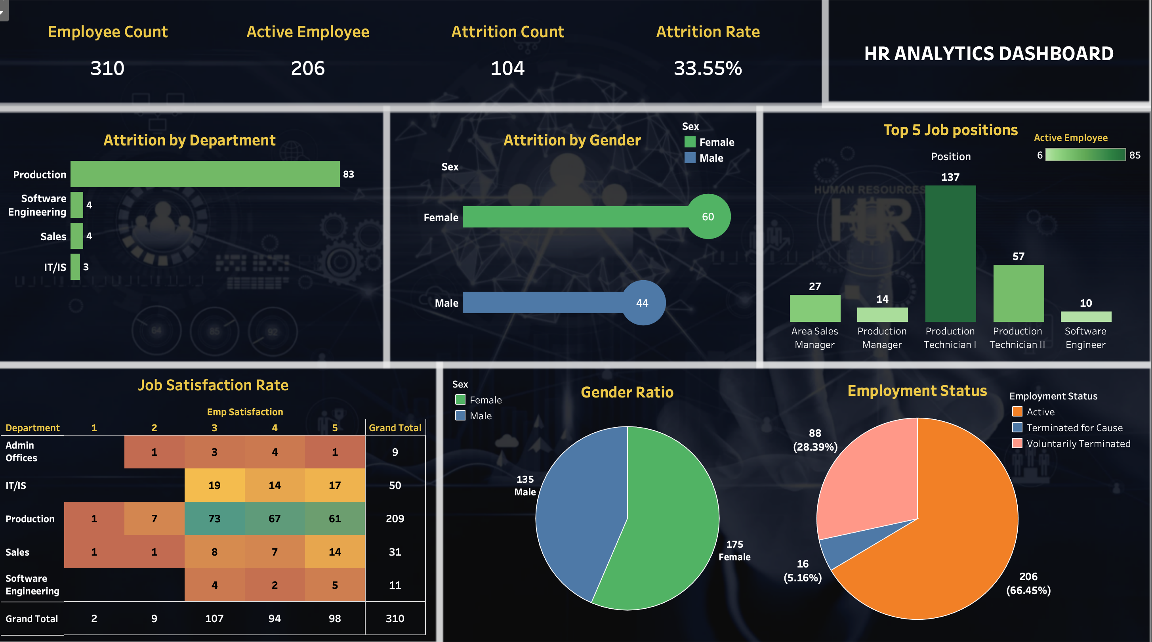

Slide 19

Conclusion
In conclusion, the data visualization of the HR dataset has provided us with a compelling and comprehensive insight into various aspects of human resource within an organization. The visual representation of data have transcended the confines of spreadsheets and raw numbers, offering a clear and dynamic understanding the HR processes.
The visualization also, underscores the importance of harnessing data to drive change and improve HR practices. It emphasizes the significances of focusing on areas such as employee engagement, talent acquisition, and retention, with the ultimate goal of creating a workplace that fosters growth, diversity, and inclusivity.

